Slide 1
Low – Rank Adaption
Nick, ray, Sanjana

Slide 2
Transfer Learning
Adapts pre trained models to new tasks
Can be adapted across different domains such as healthcare and finance
Resourceful by working with original pretrained model instead of having to create models from scratch
Typically done through fine - tuning which adjusts all the parameters across a model
Notes:
The inception of transfer learning has allowed for deep learning models to adapt to different tasks without needing to create new models from scratch. Pretrainied models are adapted for new tasks through a full fine tuning process, which involves retraining all the parameters of a model to fit another task.

Slide 3
Challenges
Deep learning models continue to rise in number of parameters, surpassing billions and even reaching trillions
This is computationally expensive, even with best of GPU processors
GPT – 3 Model: 175 B parameters * 2 bytes ~ 350 GB A100 GPU: 80 GB of data -> 350/80 ~ 5, double the number of GPUS for training so 10 GPUs are needed ~ adding up to $200k in cost
Notes:
The inception of transfer learning has allowed for deep learning models to adapt to different tasks without needing to create new models from scratch. Pretrainied models are adapted for new tasks through a full fine tuning process, which involves retraining all the parameters of a model to fit another task.

Slide 4
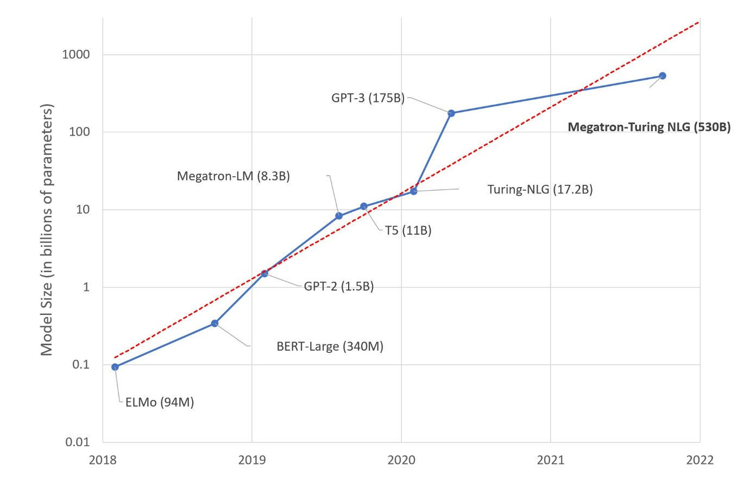

Slide 5
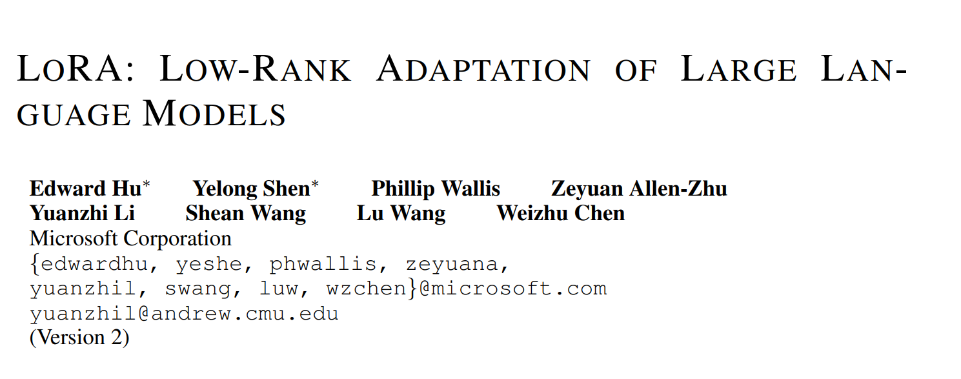
Solution
Microsoft introduced LoRA in 2021
Technique that utilizes low rank approximation to capture essential information
Performs fine – tuning on decomposed weight matrices, A and B
Result: significantly reduces the number of trainable parameters
Focus is on transformer architecture of LLM's but can be applied to deep learning models overall
Notes:
The inception of transfer learning has allowed for deep learning models to adapt to different tasks without needing to create new models from scratch. Pretrainied models are adapted for new tasks through a full fine tuning process, which involves retraining all the parameters of a model to fit another task.

Slide 6
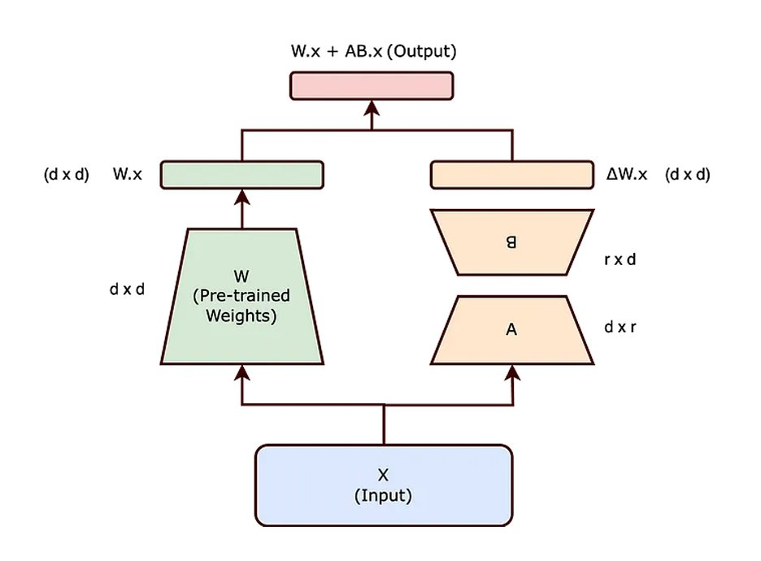
LoRA process diagram
Input weights are frozen
Decomposed into smaller weight matrices through W's rank (product of A and B ~ W)
Fine tuning performed on A and B
Added to original weight input product to produce the output

Slide 7
Section 2: Mathematical Operation

Slide 8
Low-Rank Parametrized Update Matrices
Idea of Intrinsic Dimension
Representing complex data with as few variables as possible
Can still learn efficiently despite a random projection to a smaller subspace
Hypothesis: Updates to the weights also have low Intrinsic Rank
I.E Focus only on a small number of important parameters
Notes:
NNs have many dense layers which perform matrix multiplication.
The weight matrices in these layers typically have full rank.

Slide 9
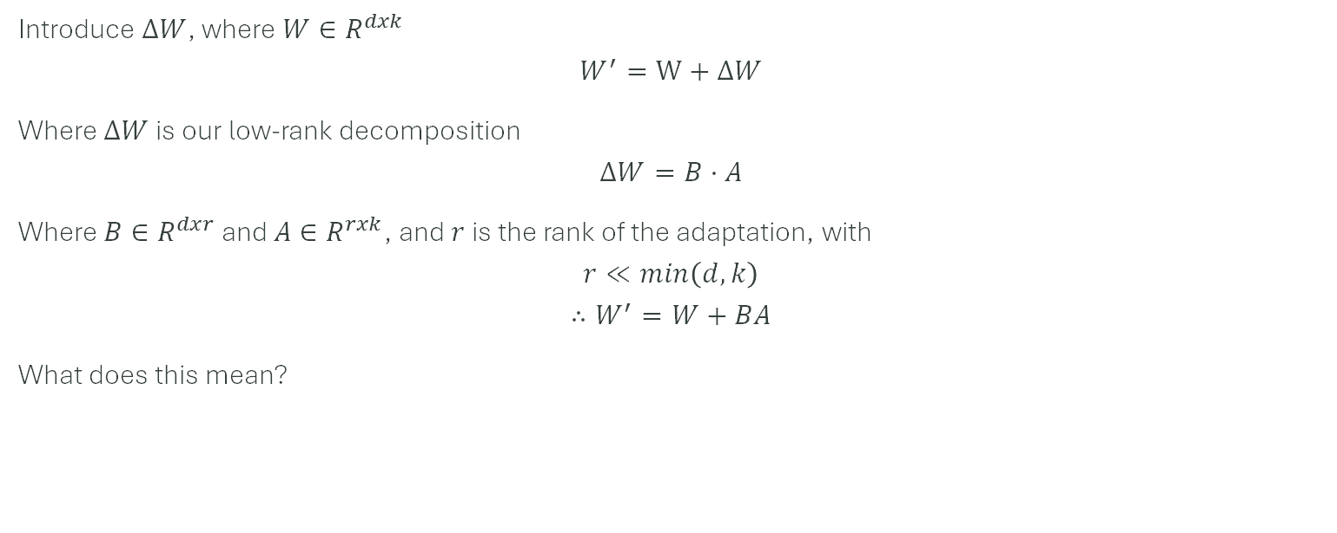
Adding a Low-Rank Adaption
Introduce $ΔW$, where $W∈R^{dxk}$
$$W^{′}=W+ΔW$$
Where $ΔW$ is our low-rank decomposition
$$ΔW=B⋅A$$
Where $B∈R^{dxr}$ and $A∈R^{rxk}$, and $r$ is the rank of the adaptation, with
$$r≪min\left(d,k\right)$$
$$∴W^{′}=W+BA$$
What does this mean?

Slide 10

Forward Pass with Adaptation
$$y=W^{′}x=\left(W+BA\right)x$$
Thus we get
$$y=Wx+B\left(Ax\right)$$
We can see that we still have the original weights $W$, and $B\left(Ax\right)$ is the low rank adaption specific to a new task.

Slide 11
Section 3: Alternative Methods

Slide 12
Fully Fine Tuning
Train Parameters for a specific task (Each task!)
Computationally- and memory-intensive
Can lead to overfitting, forgetting general knowledge
Was the main technique that was used before LoRa

Slide 13
Prefix-Tuning, Prompt Optimization
Adds trainable tokens / learnable prefixes to model input
- E.g, Prompt engineering
Performance non-monotonically changes
i.e, nebulous and unreliable to an extent
Notes:
Prompt engineering, prompt hacking,
You can’t really scale up this technique, and gives limited control with more complex desired outputs.

Slide 14
Adaptor Layers
Insert extra NN layers into architecture that are only trained on the new task.
Similarly has low-number of parameters as LoRa
Creates latency, leading to slower performance.
Notes:
Adding extra layers will obviously make the model more complex,

Slide 15
Quantization
Reduces precision of parameters (e.g, from 32-bit floats to 8-bit or lower)
Reduces memory footprint and speeds up computation
However…Doesn’t actually adapt a model to a new task.
Also potentially reduces accuracy.

Slide 16
Section 4: Empirical Results

Slide 17
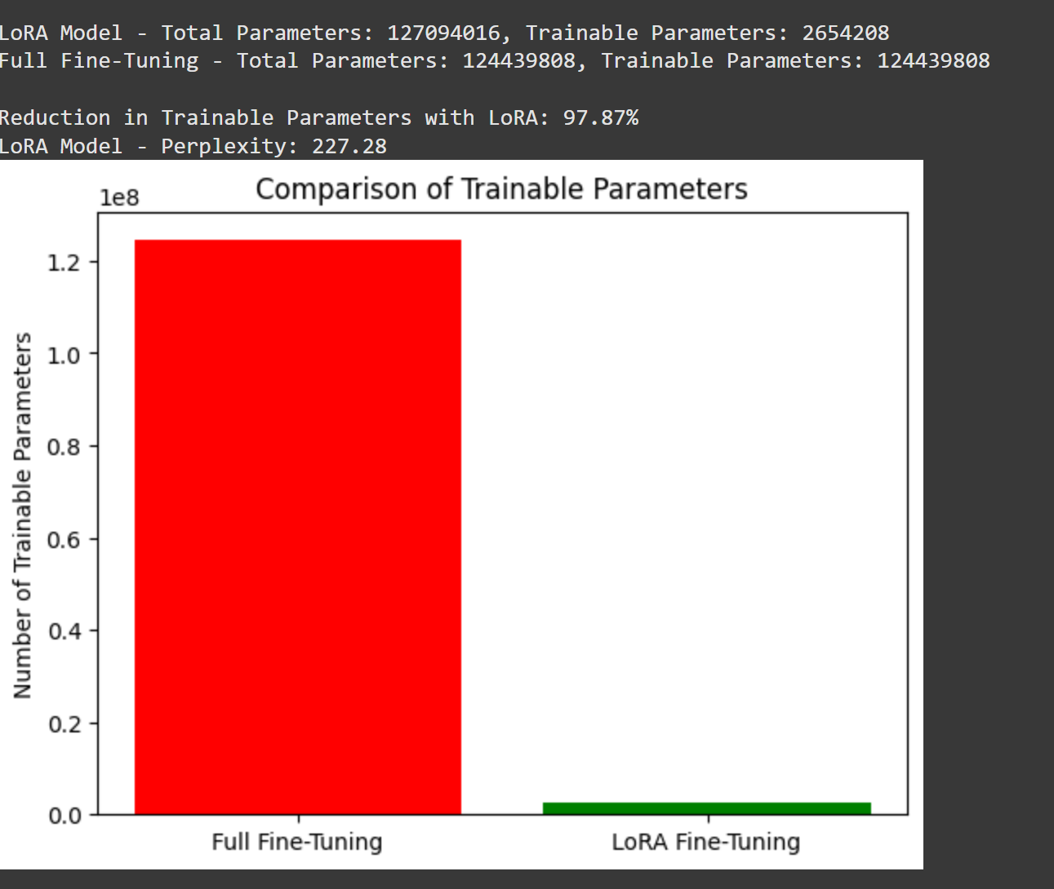
LoRA applied to GPT –2

Slide 18
Empirical Results of LoRa on Stable Diffusion
Experimental Environment
Stable diffusion uses 100% of available resources
# of parameters changed varies from LoRa to LoRa
Thus, time to complete forward pass is the only realistically measurable result.
We can also subjectively view the results of LoRa.
All factors were held constant other than the inclusion of LoRa.

Slide 19
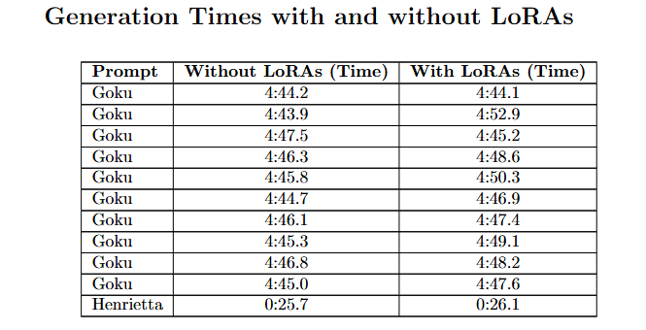
LoRa did not significantly change generation time through trials:

Slide 20
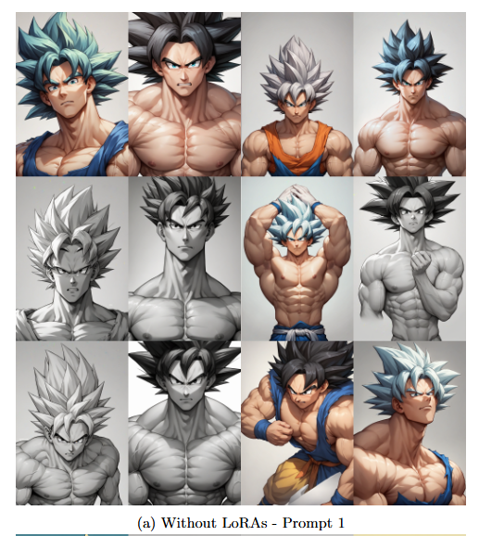
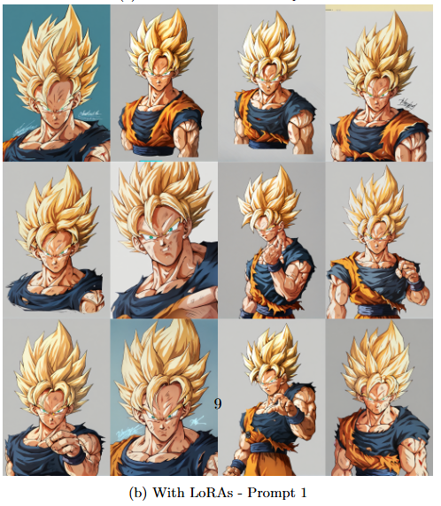

Slide 21



Sanity Check
Official Character
W/out LoRa
W/ LoRa

Slide 22
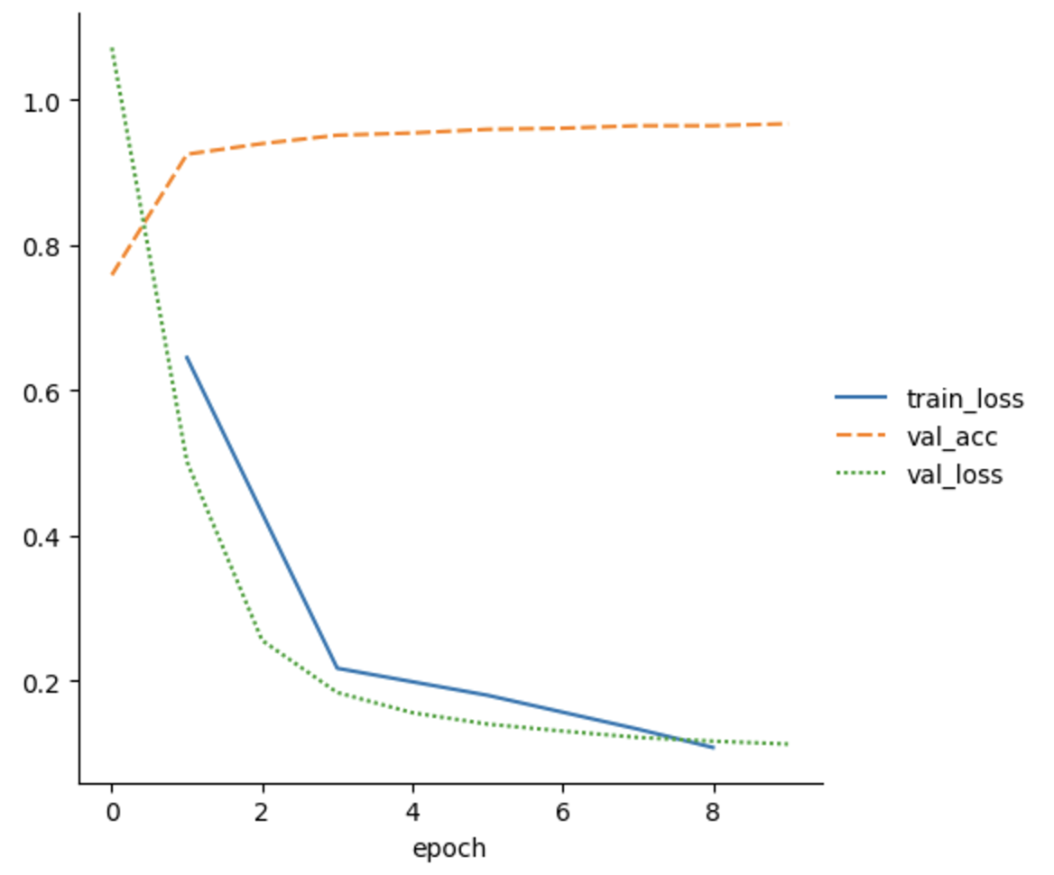
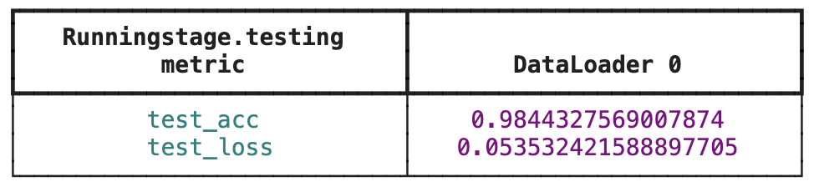
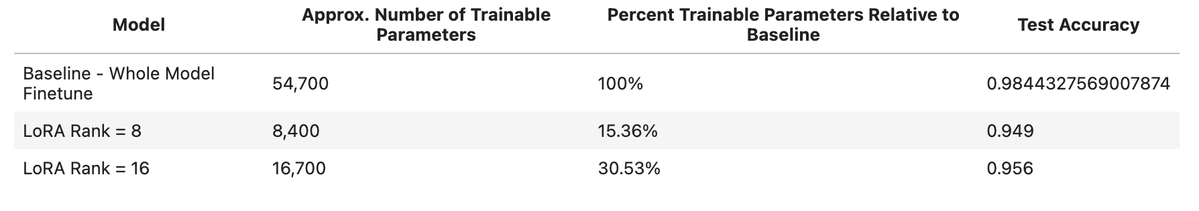
Problem Set
Pre-train a MLP for image classification
Only use 5/10 classes as training set
Fully fine-tuning the model using the remaining training examples
Use LoRA to fine-tune the model
Compare difference

Slide 23
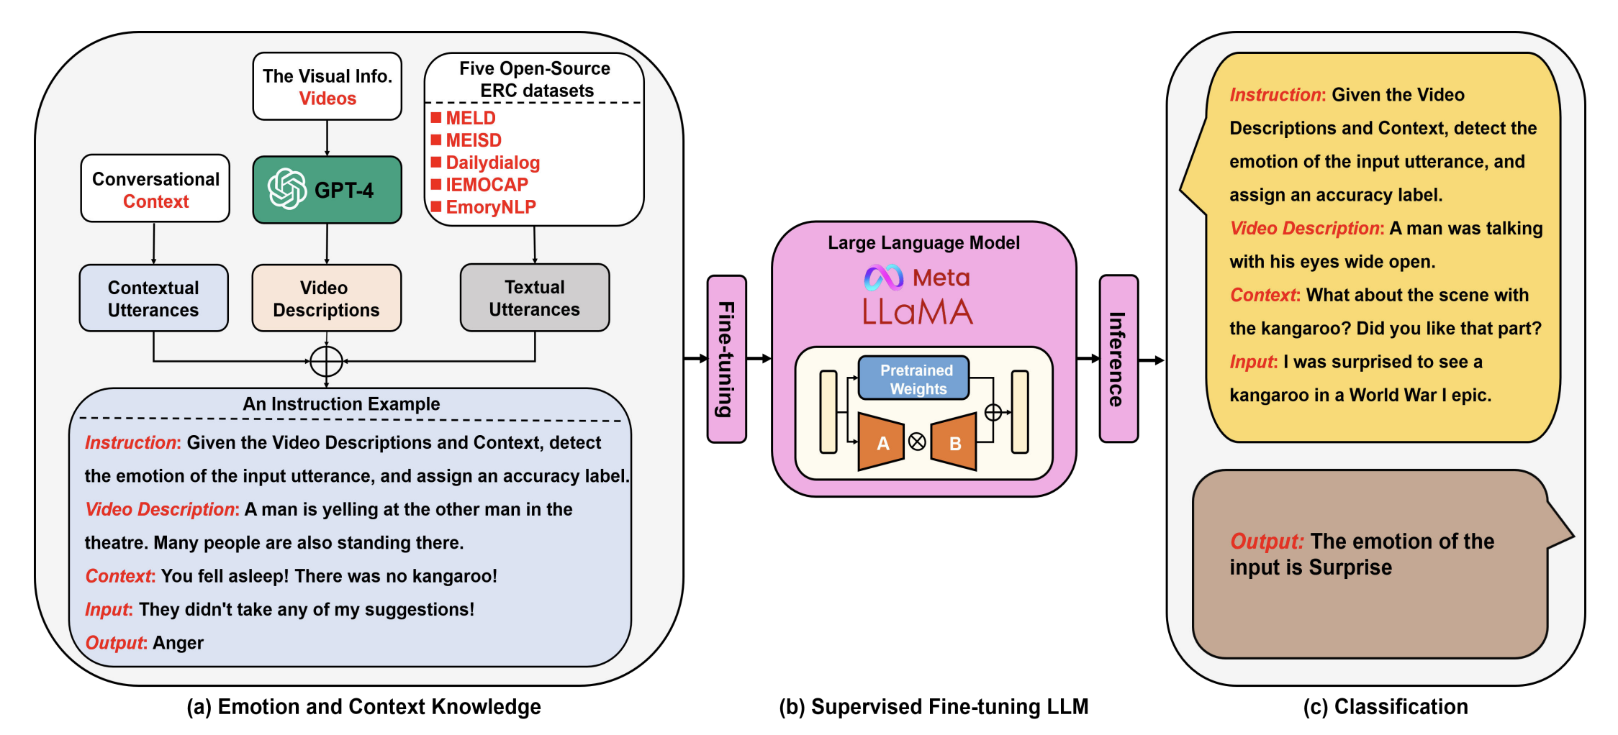
Other Application -- NLP
Emotion recognition
Text classification
Role recognition
Program repair
Text-to-SQL

Slide 24
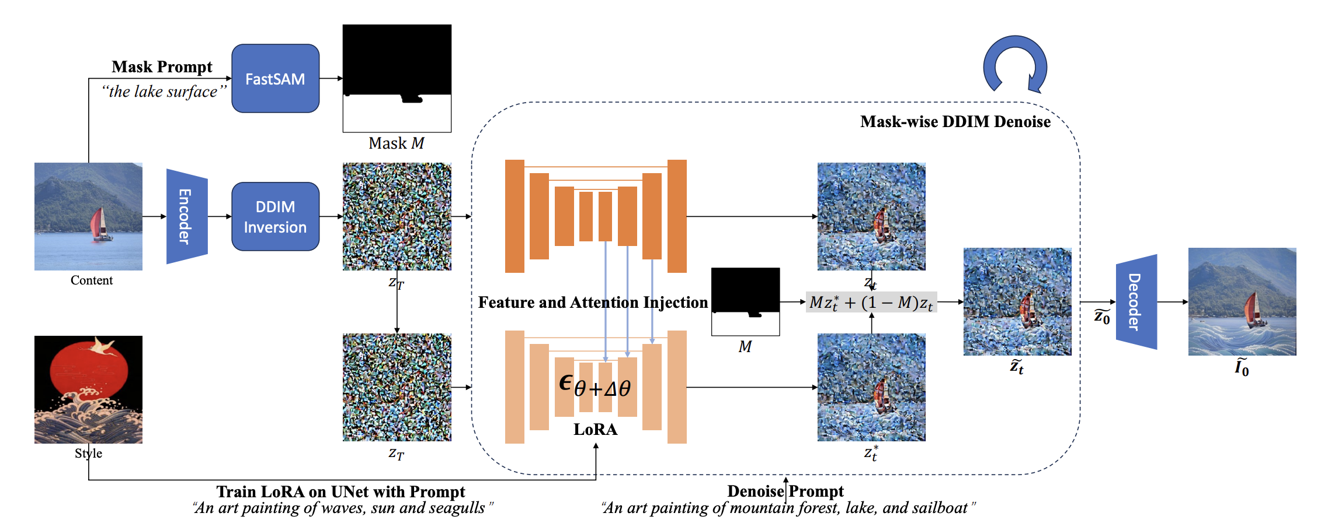
Other Application -- CV
Image generation
Image style transfer
Text-to-image generation
Image segmentation

Slide 25
Section 5: Conclusion

Slide 26
Conclusion
LoRA can be combined with other efficient adaptation methods, potentially providing orthogonal improvement.

